Slide 1
Secure data hiding in image using steganography
CAPSTONE PROJECT
Presented By:
Student Name : Md Saddam Hussan
College Name & Department : SRM University
Information Technology

Slide 2
OUTLINE
Problem Statement
Technology used
Wow factor
End users
Result
Conclusion
Git-hub Link
Future scope

Slide 3
Problem Statement
Data security is a major concern in today's digital world. Sensitive information is often transmitted through digital mediums, making it vulnerable to interception or unauthorized access. Traditional encryption methods are powerful but can attract attention from cybercriminals and forensic investigators. This project aims to provide a covert, secure, and efficient way to hide encrypted data inside images using AES-256 encryption and LSB (Least Significant Bit) steganography. The goal is to ensure that hidden messages remain undetectable while maintaining data confidentiality and integrity.

Slide 4
Technology used
Python - The main programming language for implementing encryption, decryption, and GUI.
Tkinter & ThemedTk - Used for designing an interactive and user-friendly GUI.
OpenCV (cv2) - Handles image processing for steganography.
Pillow (PIL) - Image handling and previewing functionalities.
Cryptography (Fernet AES-256) - Provides military-grade encryption and decryption of messages.
PBKDF2 (Password-Based Key Derivation Function 2) - Generates a strong encryption key from user-defined passwords.
NumPy - Helps manipulate image data efficiently.

Slide 5
Wow factors
Military-Grade Security – Uses AES-256 encryption with PBKDF2-based key generation.
Stealth Mode – Encrypted data is hidden inside images using LSB steganography, making it undetectable.
User-Friendly GUI – A clean and interactive drag-and-drop interface with progress indicators.
Image Preview Feature – Users can see the selected image before encryption.
Cross-Platform Compatibility – Works seamlessly on Windows, macOS, and Linux.
Fast Encryption & Decryption – Optimized with a progress bar for a smooth experience.
Future Expansion Ready – Can be upgraded to video steganography or AI-based detection avoidance.

Slide 6
End users
Cybersecurity Professionals – Securely transmit sensitive information.
Whistle-blowers & Journalists – Hide crucial data to prevent leaks.
Government & Intelligence Agencies – Use for secure covert communication.
Businesses & Enterprises – Store confidential messages safely inside images.
General Users – Protect personal and private data from cyber threats.

Slide 7
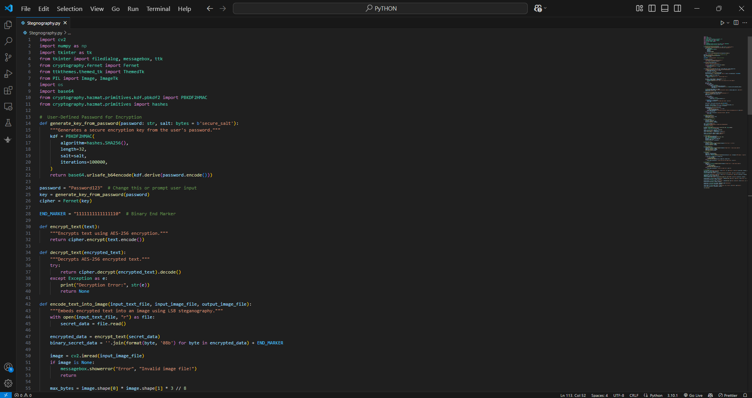
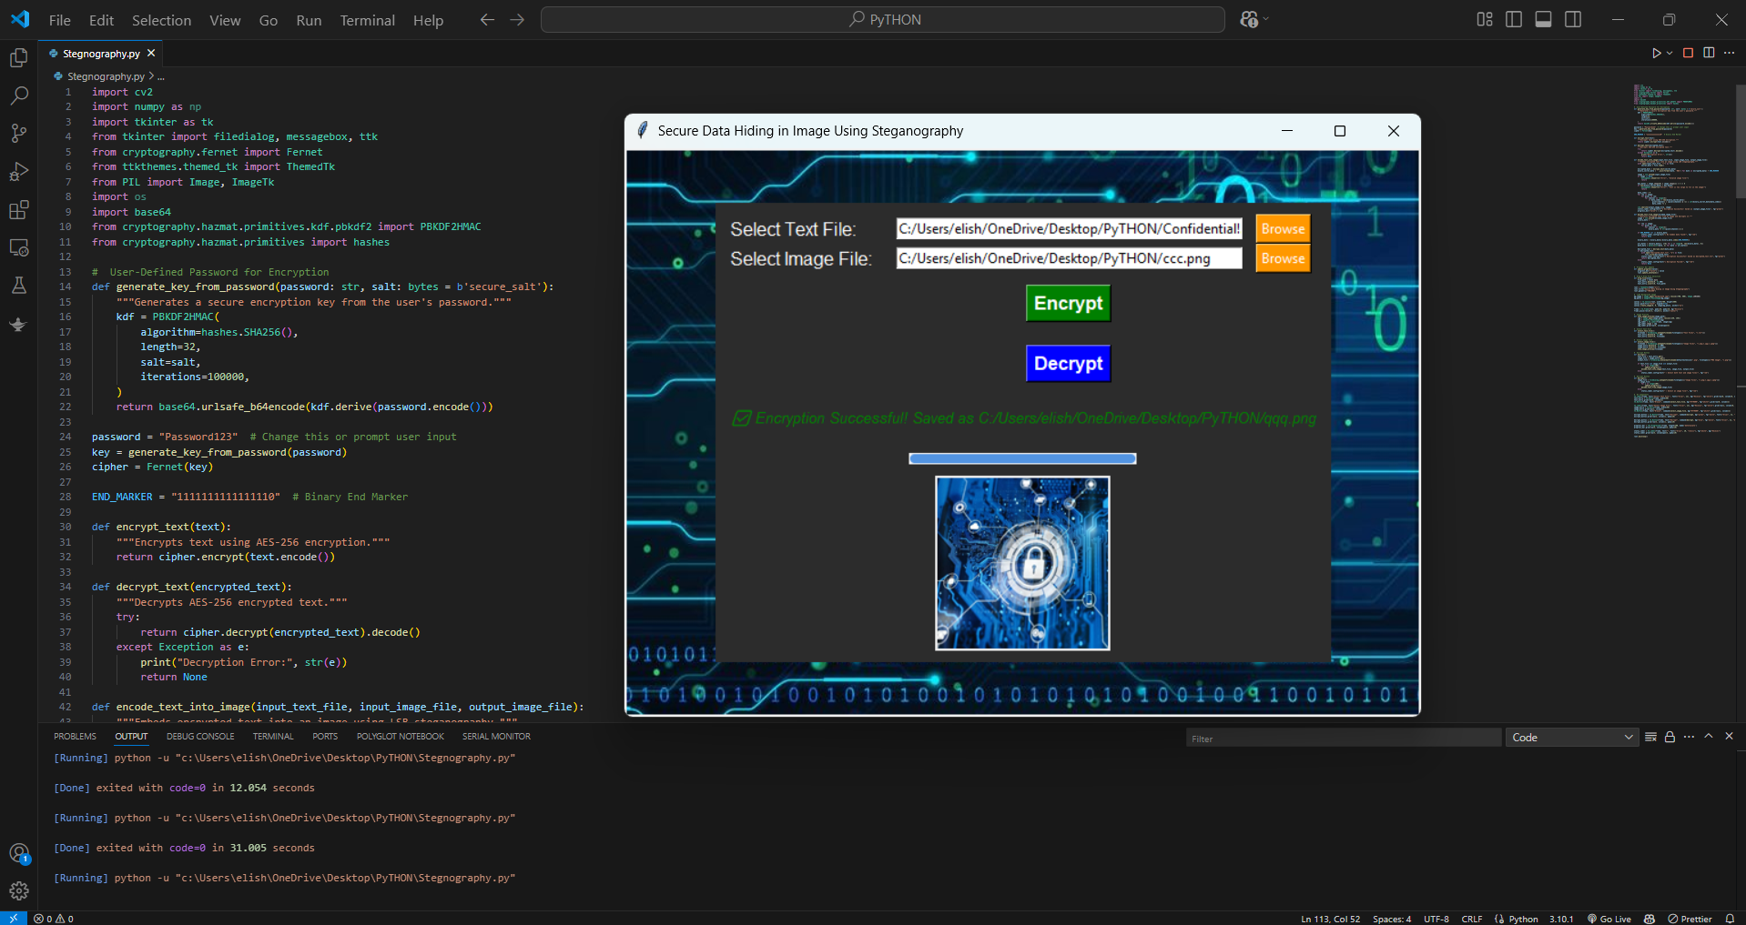

Results

Slide 8
Conclusion
This project successfully combines AES-256 encryption with image steganography to create a highly secure and undetectable data-hiding mechanism. The intuitive GUI, image preview, progress bar, and drag-and-drop functionality make it user-friendly and efficient. The password-protected encryption ensures only authorized users can retrieve data, making it a powerful cybersecurity tool for protecting sensitive information.

Slide 9
GitHub Link
https://github.com/Eli-Shane7/Steganography.git

Slide 10
Future scope(optional)
Support for Video Steganography – Hide encrypted data inside video files.
Mobile App Integration – Develop an Android/iOS version for enhanced accessibility.
AI-Powered Detection Avoidance – Implement machine learning models to make hidden data even more undetectable.
Cloud-Based Secure Storage – Store encrypted images securely in cloud platforms.
Blockchain Integration – Improve authentication & security using blockchain-based digital signatures.
Multi-User Encrypted Messaging – Enable secure chat functionality with embedded encryption inside images.

Slide 11
THANK YOU

